Slide 1
Topic Modelling and sentimental analysis
180030571 - N.Janaki
180031143 - R.Rasagna
GROUP -211
PROJECT GUIDE – DR.SASMITA PADHY (6488)

Slide 2
Contents
1.INTRODUCTION
2.ABSTRACT
3.EXPERIMENTAL ANALYSIS
4.DISCUSSIONS OF RESULTS
5.SUMMARY
6.REFERENCES

Slide 3
INTRODUCTION Topic Modelling
Topic modeling is a method in natural language processing (NLP) used to train machine learning models.
The process of logically selecting words that belong to a certain topic from within a document.
Topic modeling provides great time and effort saving benefits.
The three most common techniques of topic modeling are :
Latent Semantic Analysis (LSA)
Probabilistic Latent Semantic Analysis (pLSA)
Latent Dirichlet Allocation (LDA)
Topic modeling is a powerful technique for unsupervised analysis of large document collections.
Topic models conceive latent topics in text using hidden random variables, and discover that structure with posterior inference.
Topic models have a wide range of applications like tag recommendation, text categorization, keyword extraction and similarity search in the broad fields of text mining, information retrieval, statistical language modeling.

Slide 4
Latent Dirichlet Allocation (LDA)
LDA is a process of topic model and is used to classify text in a document to a particular topic.
It builds a topic per document model and words per topic model, modeled as Dirichlet distributions.
The core concept is replaced by Dirichlet allocations where the distribution is sampled over a probability simplex.
The total desired number of topics is set as ‘k’ in the dimensional Dirichlet distribution.
The LDA model reads every document, assigns each word to one of the ‘k’ topics, and provides a representation of the words and documents for a given topic.
LDA is proven to deliver accurate results for topic modelling use cases.
LDA represents documents as mixtures of topics that spit out words with certain probabilities.

Slide 5
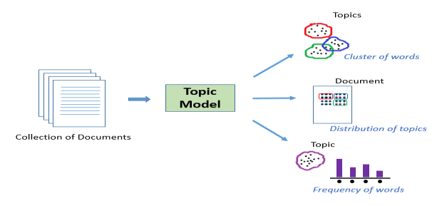
FLOW OF LDA

Slide 6
Sentimental Analysis
Text Analysis is automated method process of translating large volumes of unstructured text into qualitative data to uncover insights , trends , patterns.
Sentimental analysis is spoken out of computational study of text analysis to find and extract the subjective study of big data
It is used to analyze the users review from social media
SENTIMENTAL ANALYSIS FOR SOCIAL MEDIA:
In this social media the role of sentimental analysis, identifying opinionative data
In web and classifying them according to their polarity SA is used.
It is a problem based on text analysis
It helps in hidden sentiments identification and poly semy

Slide 7
Challenges of SA
Incremental Approach :
Analysis of real time data is not one time operation. Whenever data is added we need to do analysis then why should not we use the previous analysis result.
Parallel Computing For Massive Data :
If we divide the computation into tasks or processes that can be executed simultaneously, then there can be an improvement in the speed through the use of parallelism.
Credibility/Behavior/Homophily Behaviors :
In social media are only observed by the traces they leave in social media.
Sarcasm :
can be used to hurt or offend or can be used for comic affect. It means false positives
Grammatically Incorrect Words:
There are many approaches that analyze sentiments but hardly any work accomplished on grammatical errors.
Review Author Segmentation :
Opinion towards a target may be specified by many people who can be called as review authors. Depending on the commenting style of these authors
Refinement Of existing Lexicons or Updating/Down:
Dating Lexicons Many people comments, the Performance of sentiment analyzer depend on the correctness of the lexicon.

Slide 8
Goal of SA
The main goal of this paper is to give an overview of latest updates in sentiment analysis and classification methods and it includes the brief discussion on the challenges of sentiment analysis for which the work needs to be done.
Masses of users share their feelings on social media, making it a valuable platform for tracking and exploring public sentiment.

Slide 9
SARCASM ANALYSIS
Sarcasm is a nuanced form of communication where the individual states opposite of what is implied.
major challenges of sarcasm detection is its ambiguous nature. There is no prescribed definition of sarcasm.
Every day hundreds of new slang words are being created and used on these sites.
Existing corpus of positive and negative sentiments may not prove to be accurate in detecting sarcasm.
Due to these difficulties and the inherently tricky nature of sarcasm it is generally ignored during social network analysis.
sarcasm detection poses to be one of the most critical problems which we need to overcome.
NLP based systems such as text summarization and sentiment analysis
the problem of sarcasm detection by leveraging the most common expression of sarcasm
“positive sentiment attached to a negative situation

Slide 10
ABSTRACT
Topic Modelling using LDA and Sentimental Analysis is the Project entitled as. Coming to the Project implementation the Project encloses of 2 Modules, module 1 deals with the topic modelling using LDA whereas module 2 deals with the sentimental analysis. The 2 main algorithms which are used in this project are Latent Dirichlet Allocation (LDA) and Naïve Bayes Algorithm.
Discussing about the module 1 about topic modelling using LDA algorithm, topic modelling is a process in Natural Language Processing (NLP) which is generally used to train the machine learning models to attain the actual required results for the targeted objective.
The process of selecting the words logically that actually belong to certain topic within a given document. This Topic Modelling provides a very great time and also effort saving benefits. Coming to LDA algorithm this is process of the topic model and which is used to classify text in a document to a particular topic it provides the information on the topic which is document is actually based on.
To explain briefly regarding the LDA algorithm, it builds a topic for each document model and the respective topics for the topic model, which is modeled as Dirichlet distributions. The main core concept will be actually replaced by the Dirichlet allocations where the distribution is mainly over a probability simplex.
We have taken a dataset comprising of different emails and concluded by identifying the various topics which is actual dataset is comprising of. With this we can easily identify what the mails are talking about. So like this we can work on large datasets to identify the topics hidden.
Module 2 is about sentimental Analysis It is automated method process of translating the large volumes of the data which is unstructured into the most qualitative data to uncover the hidden patterns and the emotion of the data this is mostly used to study the data of social media, The main role is identifying opinionative data, it is used for the computational study of text analysis to find the subject and emotion hidden.

Slide 11
EXPERIMENTAL ANALYSIS TOPIC MODELLING
Decide on the number of words N the document will have (say, according to a Poisson distribution).
Choose a topic mixture for the document (according to a Dirichlet distribution over a fixed set of K topics).
Generate each word wi in the document by:
First picking a topic
Using the topic to generate the word itself (according to the topic’s multinomial distribution).
→Assuming this generative model for a collection of documents, LDA then tries to backtrack from the documents to find a set of topics that are likely to have generated the collection.

Slide 12
SENTIMENTAL ANALYSIS
Let us tell A tweet can be a positive phrase, negative phrase or it can be a combination of mixed emotions.
work identifies sarcasm that may exist as a contrast of positive and negative sentiments expressed through words or emoticons.
we identify the tweet sentiment, whether it is positive, negative or both.
After that we extract the emoticons. On the basis of these two combinations we conclude the tweet type as “Sarcastic” or “Non-sarcastic”.
The proposed methodology consists of the following steps:
Data extraction and cleaning
Seeding
Lexical classifier
Machine learning classifier
Emoticon extraction
Pos-neg recognition
Pragmatic classifier
Results
CONCLUSION

Slide 13
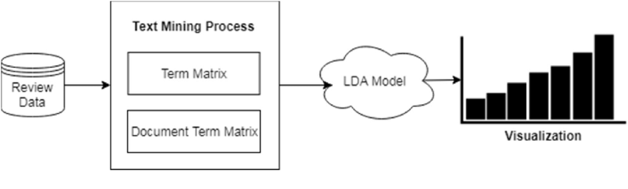
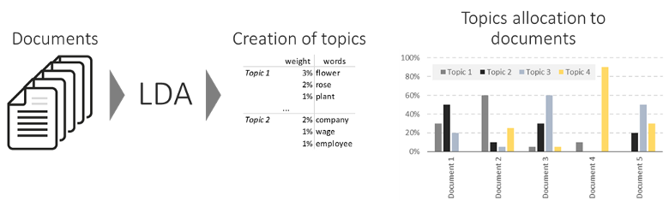
LDA REPRESENTATION

Slide 14
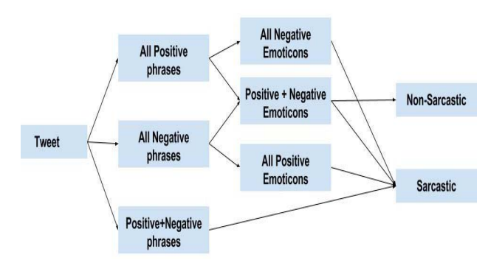
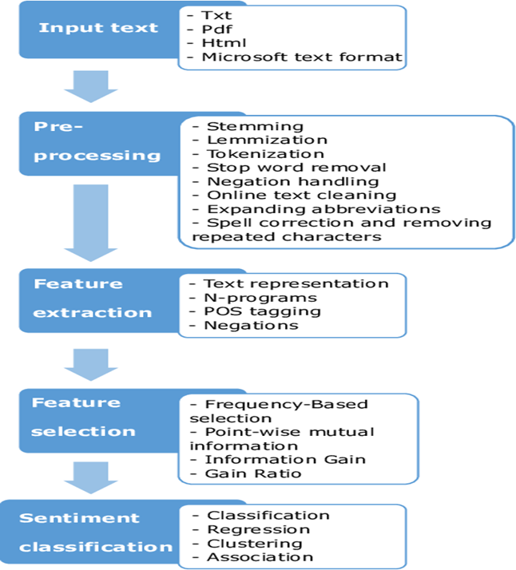
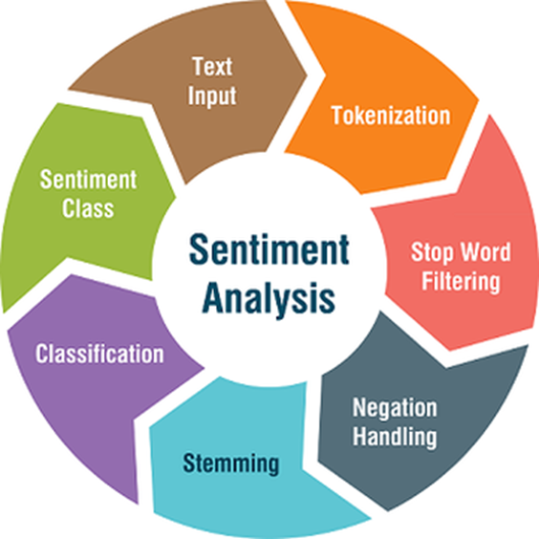
SENTIMENTAL ANALYSIS REPRESENTATION

Slide 15
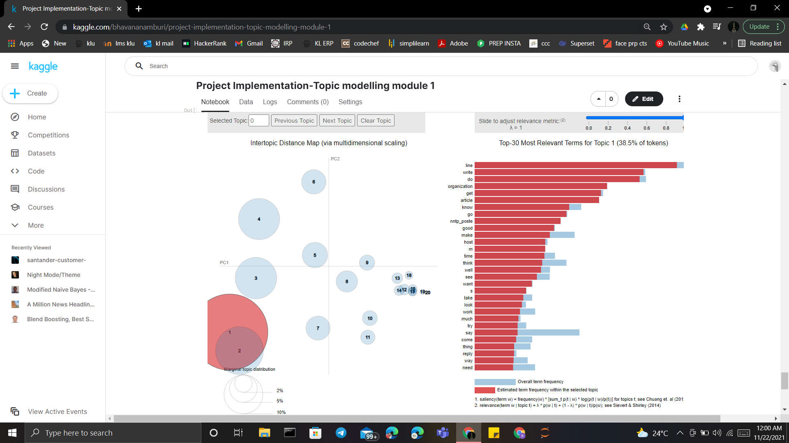
DISCUSSION OF RESULTS
MODULE 1 OUTPUT

Slide 16
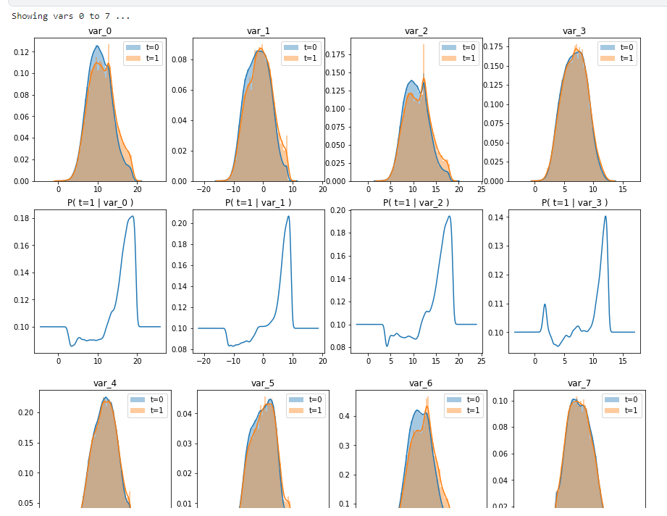
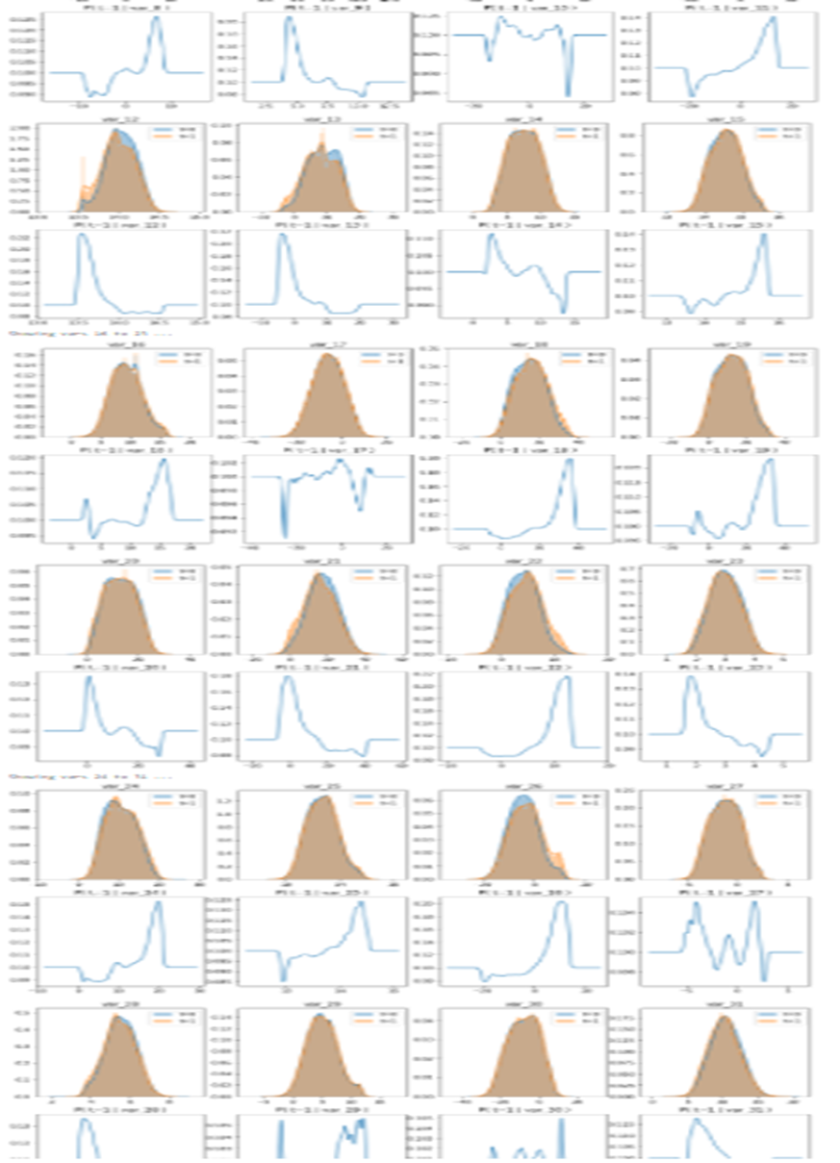
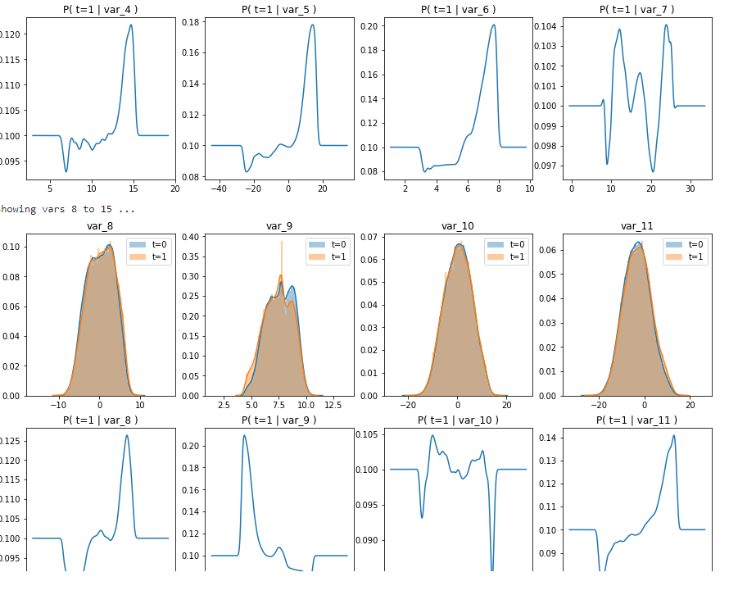
MODULE 2 OUTPUT

Slide 17
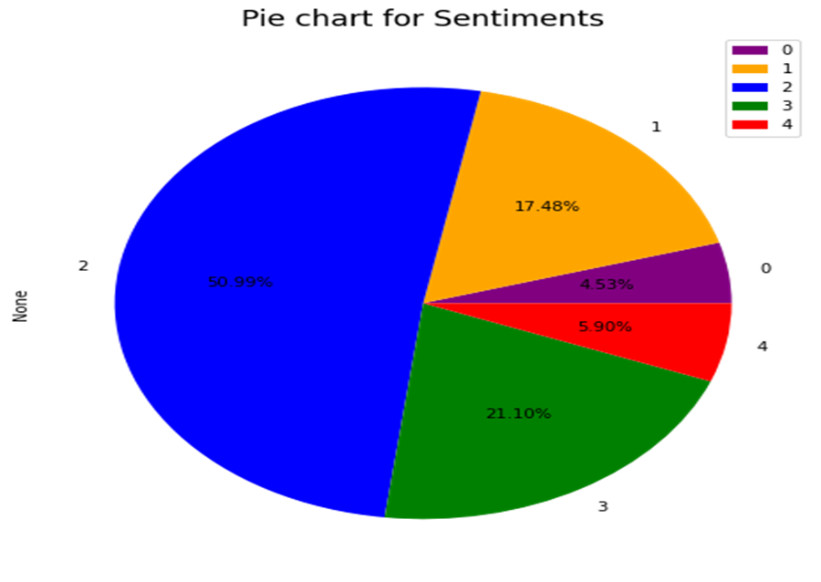
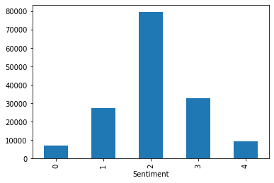
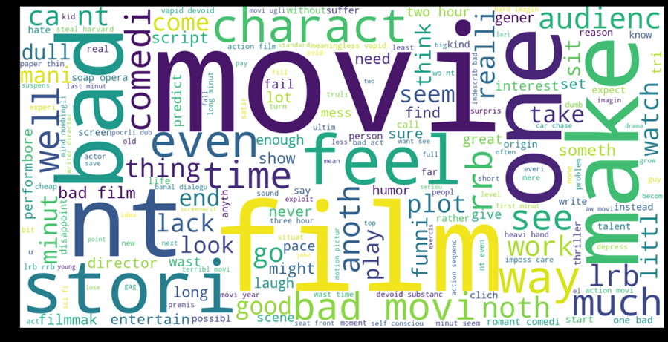
MODULE 3 OUTPUT

Slide 18
OVERVIEW OF RESULTS MODULE 1 CODE RESULT: The actual data set is json dataset which has different number of mails each email talks about different topics the main aim is to collect the data and preprocess the data by using different nltk libraries and then the ultimate result is that we get an interactive plot representing the first 20 email and the distribution frequency of each word in the email, form the plot we will be able to understand what is the email actually about just by looking at the output this is very interactive so that anyone can easily understand the result just by looking at the output. Data visualization usually plays very important role to understand the data. MODULE 2 OUTPUT: From module 2 Naive Bayes to predict Santander Customer transactions. Since we achieved an accurate score of 0.899 (which rivals other methods that capture interactions), this helps us to demonstrate that there is little or I think no interaction between the 100 variables. Besides in this kernel we observed some fascinating EDA which provide insights about the variables. There are different other insights to discover. MODULE 3 OUTPUT: We have taken a dataset and performed the different sentimental analysis function to understand the data and tried focusing on what areas is the data actually focusing, being the movie data set we got to understand it is talking about the films and seeing the word cloud according to different queries we were able to identify the which is the result by observing the largest size of the word in the give word cloud.

Slide 19
CONCLUSION
The purpose of the entire project is to explore the different datasets, choose the accurate model and fit the dataset according to the model, predict the outputs as per the datasets you could get proper understanding of the dataset, in the modern era of the big unstructured data we need to understand the appropriate models and process which helps us accurately understand the data and use it efficiently.
On this particular topic models, we need to report the initial results understand the data by topic modelling we have understood that any millions of data can easily be preprocessed and get to know what the data is all about just by using this topic modelling and different probabilistic methods such LDA, PSLDA and many more.
By working on the sentimental analysis there actually many approaches that analyze the sentiments but they hardly work on the different grammatical errors, using sentimental analysis we can actually know the intention behind the phrase, we can understand if there any reviews it helps us a lot understand in the context of customers.
Though there are many advantages to work with sentimental analysis we do have different challenges on the sentimental analysis
Massive users do share their opinions and their intentions through the social media, it being a very vital platform of the modern era, with the big data flowing each second, research areas trying to work on the new techniques which can accurately work on the data like sentimental analysis and semantic analysis work on the data providing efficient results of the data.
The traditional classification data does not actually provide or work that accurate of latest technologies and methods such as machine learning Natural language processing, deep learning, artificial intelligence and many more.

Slide 20
REFERENCES IEEE PAPERS
1. Sentiment Analysis for Social Media: A Survey - Harshali P. Patil
2. Text Sentiment Analysis: A Review - Ronglei Hu, Lu rui
3. Sarcasm Detection of Tweets: A comparative Study - Tanya Jain, Nilesh Agarwal
4. L D A Based Topic Modeling of Journal Abstracts – P.Anupriya
5. Sentimental Analysis on Product Reviews B Ramya Sree1 , Potlapally Sai Vivek2 , Ram, V Divyavani
6. Topic Modelling for Short Text Jocelyn Mazarura, Alta de Waal, Frans Kanfer and Sollie Millard Department of Statistics, University of Pretoria Centre for Artificial Intelligence Research (CSIR Meraka) South Africa
7. T. Iwata H. Sawada, Topic model for analyzing purchase data with price information. Data Mining and Knowledge Discovery, 26(3), pp.559-573, 2013
8. C. Lin H. Yulan, ”Joint sentiment/topic model for sentiment analysis.” In Proceedings of the 18th ACM conference on Information and knowledge management, pp. 375-384. ACM, 2009.
9. L. Hong D.D Brian, “Empirical study of topic modeling in twitter.” In Proceedings of the First Workshop on Social Media Analytics, pp. 80-88. ACM, 2010.

